Slide 1
RSA
&
Diffie-Hellman

Slide 2
RSA
by Rivest, Shamir & Adleman of MIT in 1977
best known & widely used public-key scheme
uses large integers
security due to cost of factoring large numbers
Notes:
RSA is the best known, and by far the most widely used general public key encryption algorithm.

Slide 3
RSA Key Setup
each user generates a public/private key pair by:
selecting two large primes at random - p, q
computing their system modulus N=p.q
  note ø(N)=(p-1)(q-1)
selecting at random the encryption key e
    where 1<e<ø(N), gcd(e,ø(N))=1
solve following equation to find decryption key d
  e.d=1 mod ø(N) and 0≤d≤N
publish their public encryption key: KU={e,N}
keep secret private decryption key: KR={d,p,q}
Notes:
This key setup is done once (rarely) when a user establishes (or replaces) their public key. The exponent e is usually fairly small, just must be relatively prime to ø(N). Need to compute its inverse to find d. It is critically important that the private key KR={d,p,q} is kept secret, since if any part becomes known, the system can be broken. Note that different users will have different moduli N.

Slide 4
RSA Use
to encrypt a message M the sender:
  obtains public key of recipient KU={e,N}
  computes: C=Me mod N, where 0≤M<N
to decrypt the ciphertext C the owner:
  uses their private key KR={d,p,q}
  computes: M=C^{d} mod N
note that the message M must be smaller than the modulus N

Slide 5
RSA Example
Select primes: p=17 & q=11
Compute n = pq =17×11=187
Compute ø(n)=(p–1)(q-1)=16×10=160
Select e : gcd(e,160)=1; choose e=7
Determine d: de=1 mod 160 and d < 160 Value is d=23 since 23×7=161= 10×160+1
Publish public key KU={7,187}
Keep secret private key KR={23,17,11}
Notes:
Here walk through example using “trivial” sized numbers.
Selecting primes requires the use of primality tests.
Finding d as inverse of e mod ø(n) requires use of Inverse algorithm (see Ch4)

Slide 6
RSA Example cont
sample RSA encryption/decryption is:
given message M = 88 (nb. 88<187)
encryption:
  C = 88⁷ mod 187 = 11
decryption:
  M = 11²³ mod 187 = 88
Notes:
Rather than having to laborious repeatedly multiply, can use the "square and multiply" algorithm with modulo reductions to implement all exponentiations quickly and efficiently (see next).

Slide 7
RSA Key Generation
users of RSA must:
  determine two primes at random - p, q
  select either e or d and compute the other
primes p,q must not be easily derived from modulus N=p.q
  means must be sufficiently large
  typically guess and use probabilistic test
Notes:
Both the prime generation and the derivation of a suitable pair of inverse exponents may involve trying a number of alternatives, but theory shows the number is not large.

Slide 8
RSA Security
approaches to attacking RSA:
  brute force key search (infeasible given size of numbers)
  mathematical attacks (based on difficulty of computing ø(N), by factoring modulus N)

Slide 9
The Diffie-Hellman Algorithm

Slide 10
Introduction
Discovered by Whitfield Diffie and Martin Hellman
  “New Directions in Cryptography”
Diffie-Hellman key agreement protocol
  Exponential key agreement
  Allows two users to exchange a secret key
  Requires no prior secrets
  Real-time over an untrusted network

Slide 11
Introduction
Security of transmission is critical for many network and Internet applications
Requires users to share information in a way that others can’t decipher the flow of information
  “It is insufficient to protect ourselves with laws; we need to protect ourselves with mathematics.”
  -Bruce Schneier

Slide 12
Introduction
No known successful attack strategies*

Slide 13
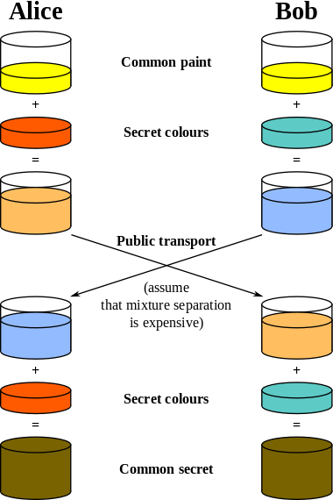

Slide 14
Implementation
p and g are both publicly available numbers
  p is at least 512 bits
Users pick private values a and b
Compute public values
  x = gª mod p
  y = g^{b} mod p
Public values x and y are exchanged

Slide 15
Implementation
Compute shared, private key
  k_{a} = yª mod p
  k_{b} = x^{b} mod p
Algebraically it can be shown that k_{a} = k_{b}
  Users now have a symmetric secret key to encrypt

Slide 16
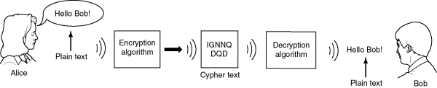
Example
Two Internet users, Alice and Bob wish to have a secure conversation.
  They decide to use the Diffie-Hellman protocol

Slide 17
Example
Alice and Bob use public numbers
  P = 23, G = 9
  select private values, a=4 and b=3
Alice and Bob compute public values
  X = 9⁴ mod 23 = 6561 mod 23 = 6
  Y = 9³ mod 23 = 729 mod 23 = 16
Alice and Bob exchange public numbers

Slide 18
Example
Alice and Bob compute symmetric keys
  k_{a} = yª mod p = 16⁴ mod 23 = 9
  k_{b} = x^{b} mod p = 6³ mod 23 = 9
Alice and Bob now can talk securely!

Slide 19
Another Example…
Alice and Bob agree to use a prime number p = 23 and g = 5.
Alice chooses a secret integer a = 6, then sends Bob A = gª mod p
  A = 5⁶ mod 23
  A = 15,625 mod 23
  A = 8

Slide 20
Bob chooses a secret integer b = 15, then sends Alice B = g^{b} mod p
  B = 5¹⁵ mod 23
  B = 30,517,578,125 mod 23
  B = 19
Alice computes s = Bª mod p
  s = 19⁶ mod 23
  s = 47,045,881 mod 23
  s = 2
Bob computes s = A^{b} mod p
  s = 8¹⁵ mod 23
  s = 35,184,372,088,832 mod 23
  s = 2

Slide 21
Strength of DH
Of course, much larger values of a, b, and p would be needed to make this example secure, since there are only 23 possible results of n mod 23.
However, if p is a prime of at least 300 digits, and a and b are at least 100 digits long, then finding out a & b is almost next to impossible given only g, p, g^{b} mod p and gª mod p.

